Slide 1
Airline Company Flight Insights Assistant​
High-Level System Architecture
Preprocessing
Graph Retrieval Layers
LLM Layer
Error Analysis & Improvements
Live Demo

Slide 2
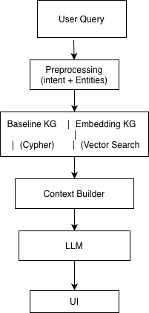
1-High-Level System Architecture
Whole pipeline :

Slide 3
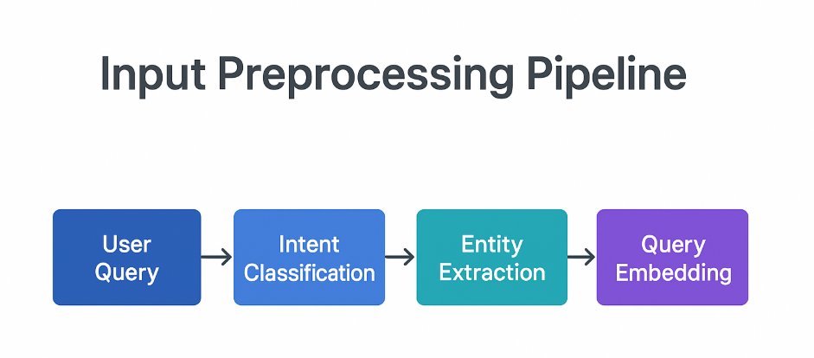
2-Preprocessing
Preprocessing overview :
This is the stage where raw user queries are processed in our airline information system to become structured data ready for querying and analysis, enabling accurate retrieval, semantic search, and data-driven insights.
How does raw English text become a structured database query

Slide 4
2-Preprocessing
Intent Classification (Rule-Based)
We use a rule-based intent classifier, designed specifically for the airline domain.
Where the classifier uses 7 ordered rule groups:
Order | Rule Type | Example keywords | Output intent
1 | Strong negative | worst, lowest, bad | worst_*
2 | Delay-related | delay, late | delay_query
3 | Satisfaction | food, comfort | satisfaction_query
4 | Class-based | business, economy | class_comparison
5 | Route-related | route, airport | route_query
6 | Recommendation | best, top | recommendation_query
7 | Fallback | none matched | general_query

Slide 5
2-Preprocessing
Entity extraction
Details mentioned in the query or in other words query parameters
We extract the following :
Airports
Flight class
Delay constraints
Satisfaction threshold
According to rules, countless if conditions categorizing words into entities.
“Flights from JFK to LAX under 20 minutes delay”
entities = {
"departure_airport": "JFK",
"arrival_airport": "LAX",
"max_delay_minutes": 20
}

Slide 6
2-Preprocessing
Embedding Step :
For when the query doesn’t get captured within the layed out rules for intent and entities
Turning a sentence into a numeric vector!
Ex:
"Which flights make me arrive way later than planned?“
[0.021, -0.113, 0.554, ...] # meaning vector

Slide 7
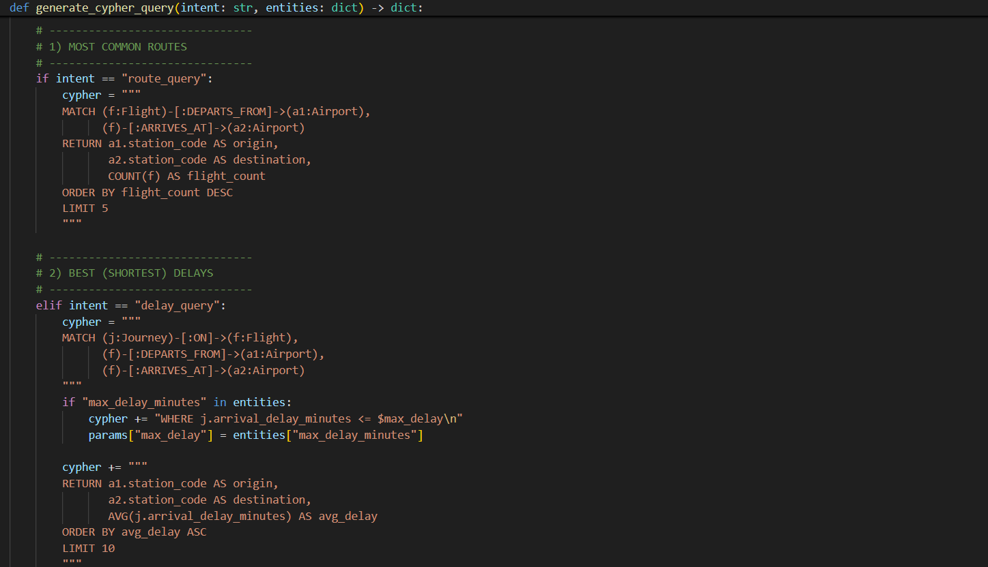
3-Graph retrieval
Baseline Retrieval :
Had A total of 11 rules

Slide 8
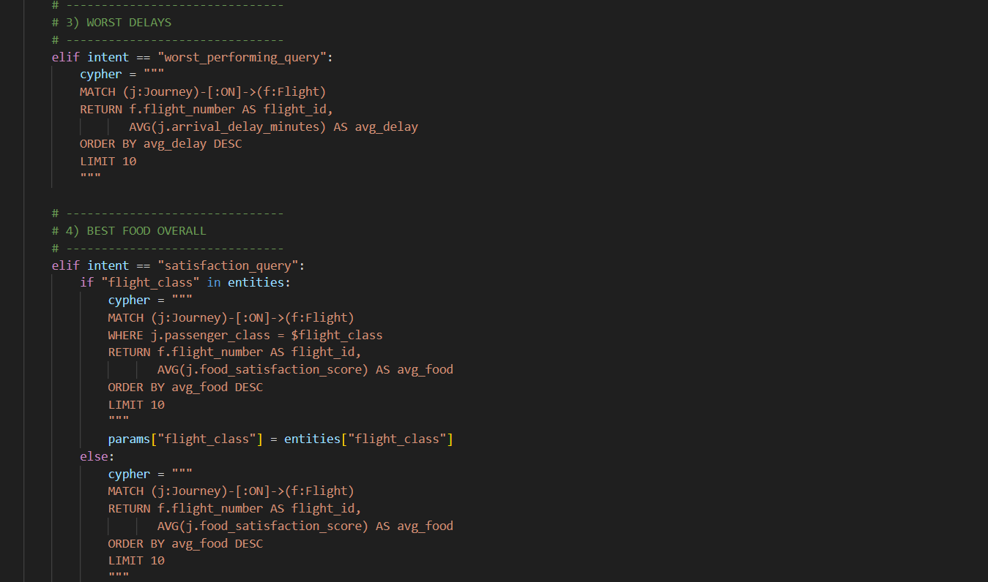
3-Graph retrieval
Baseline Retrieval :
Had A total of 11 rules

Slide 9
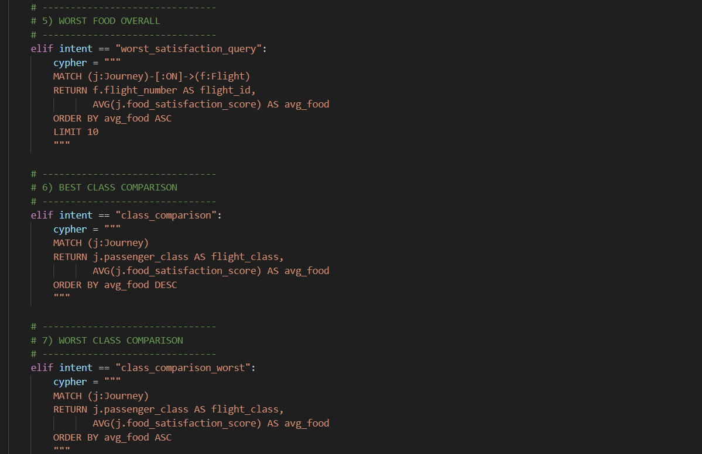
3-Graph retrieval
Baseline Retrieval :
Had A total of 11 rules

Slide 10
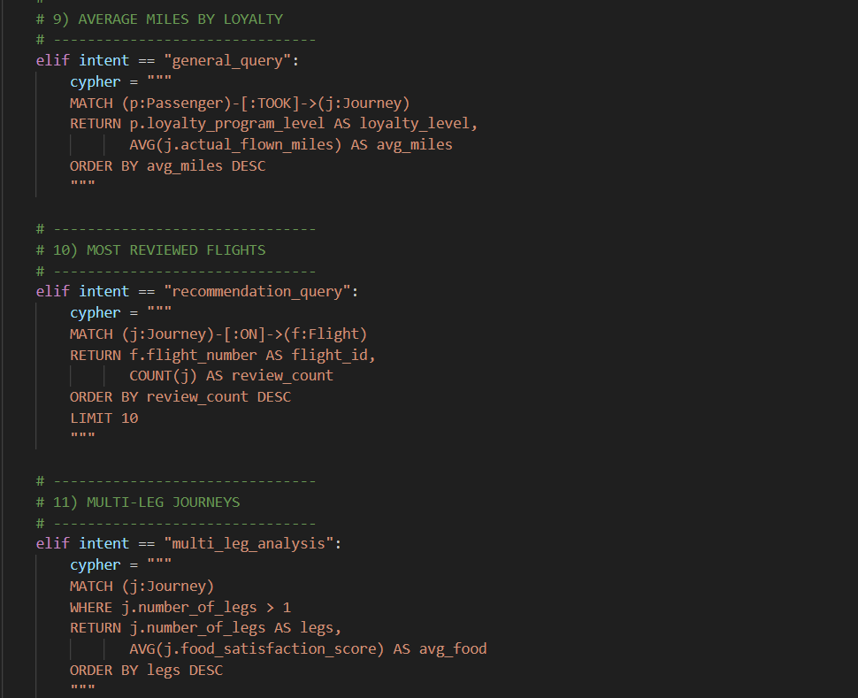
3-Graph retrieval
Baseline Retrieval :
Had A total of 11 rules

Slide 11
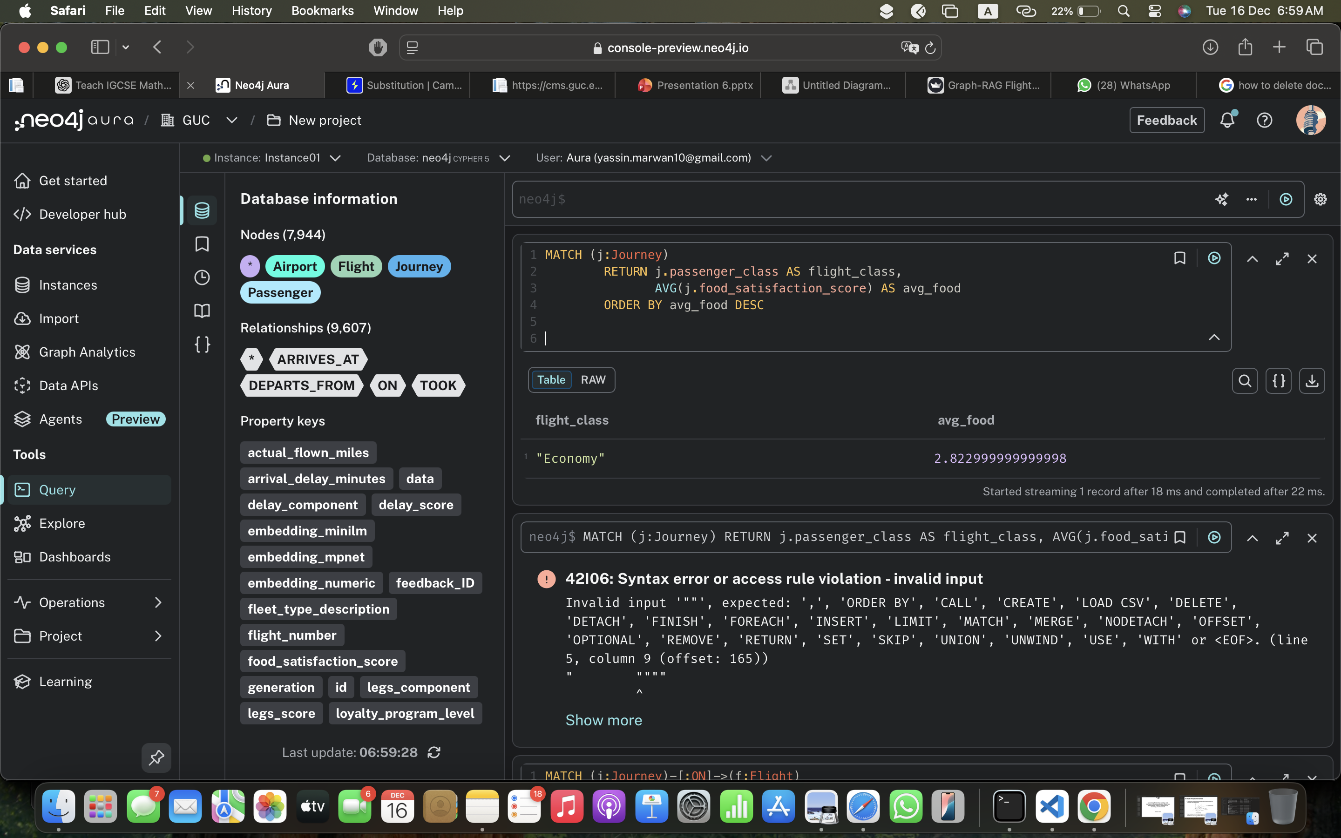
3-Graph retrieval
Baseline Retrieval :
Retrieved nodes

Slide 12
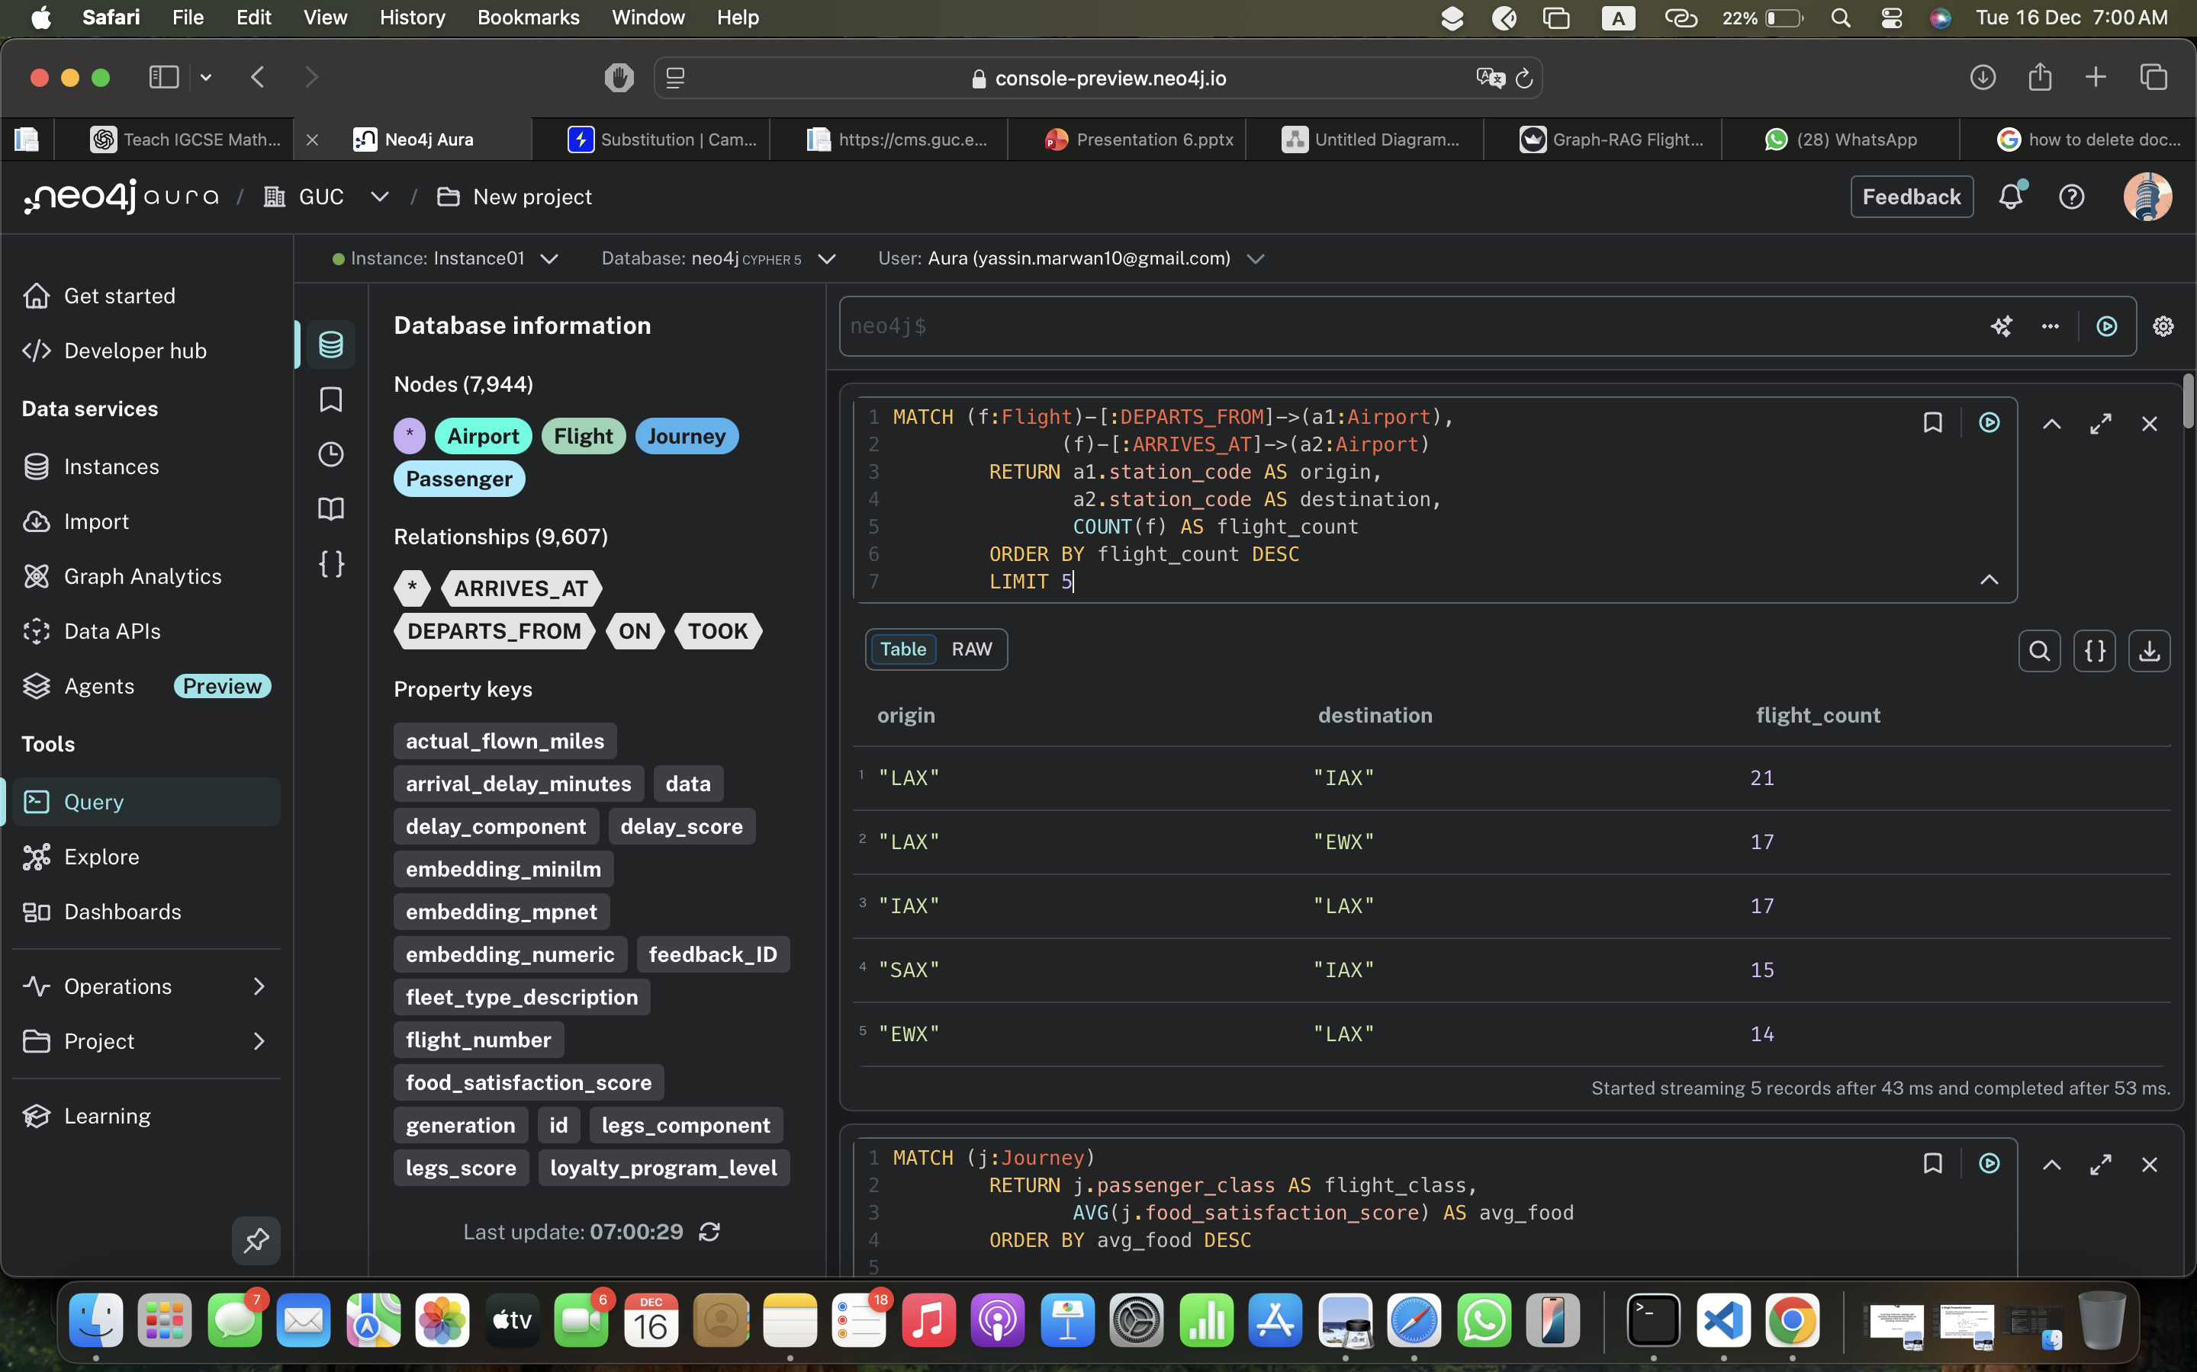
3-Graph retrieval
Baseline Retrieval :
Retrieved nodes

Slide 13
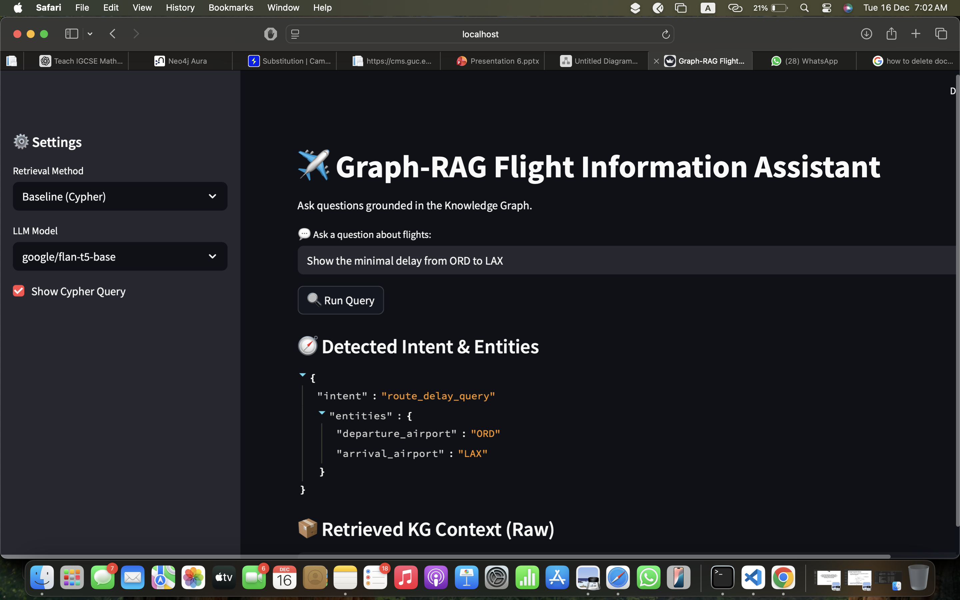
3-Graph retrieval
Baseline Retrieval :
Retrieved nodes

Slide 14
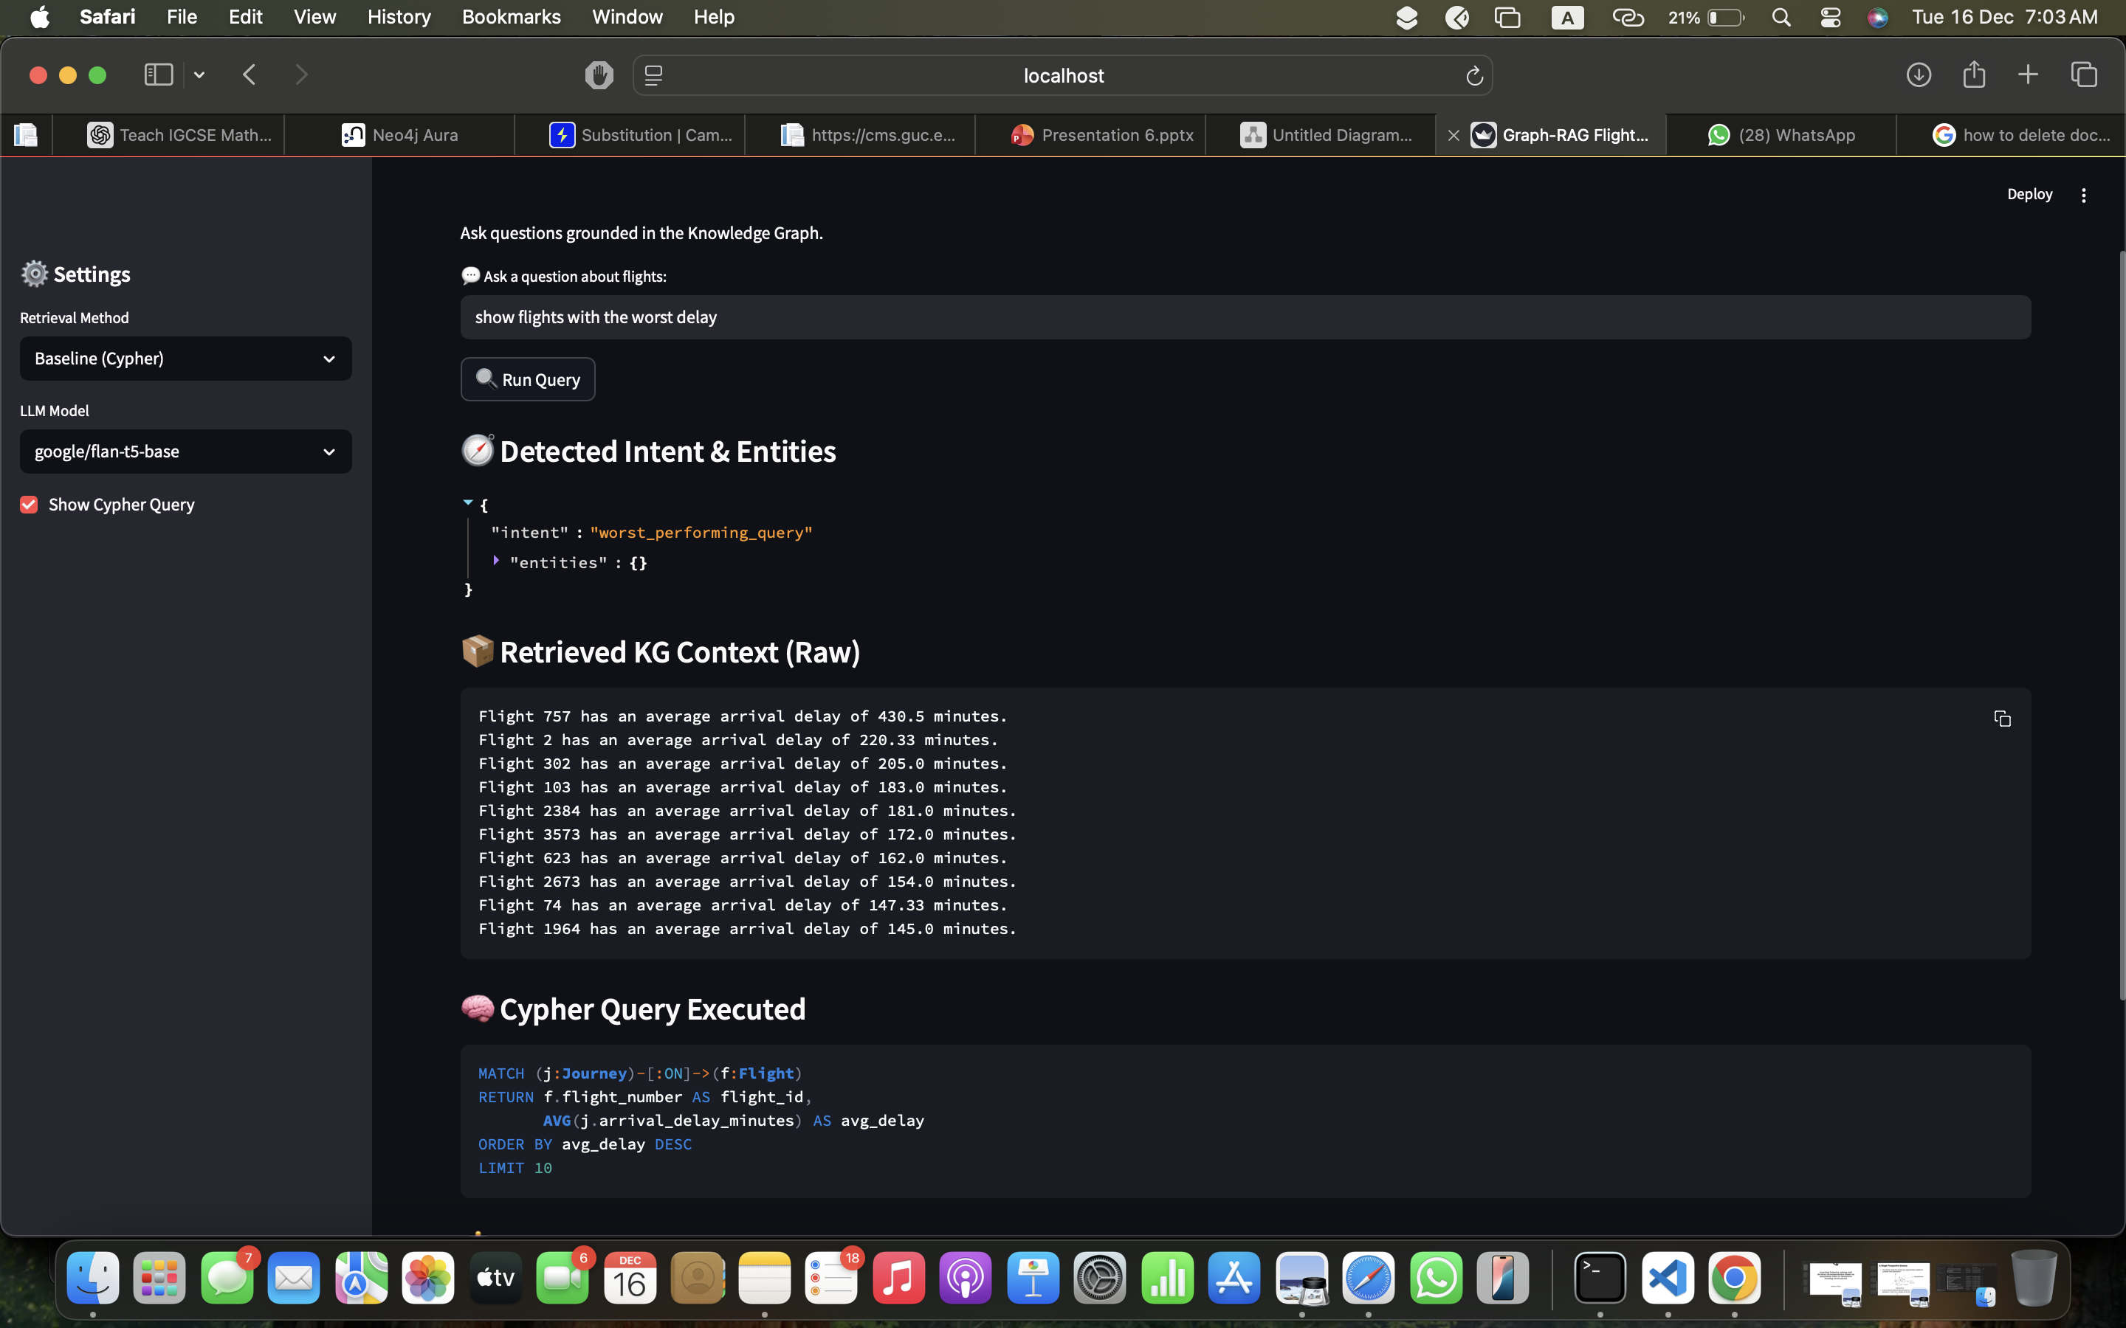

Slide 15
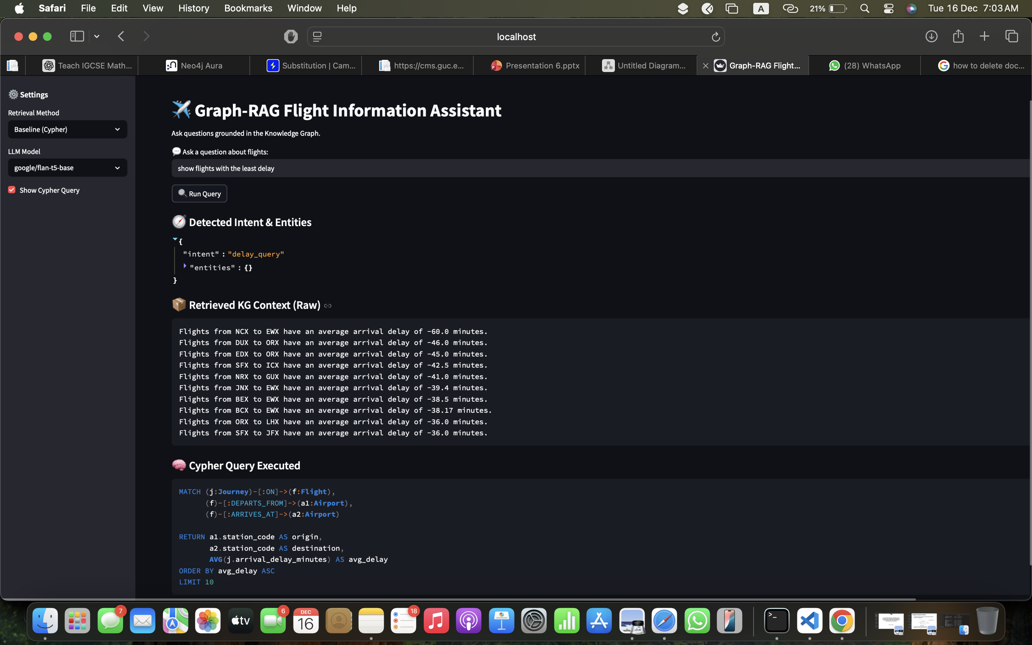

Slide 16
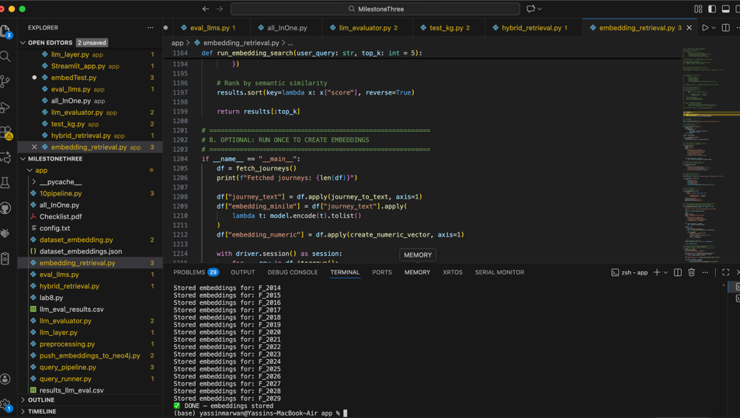
3-Graph retrieval
Embedding-Based Retrieval
Embeddings getting stored successfully

Slide 17
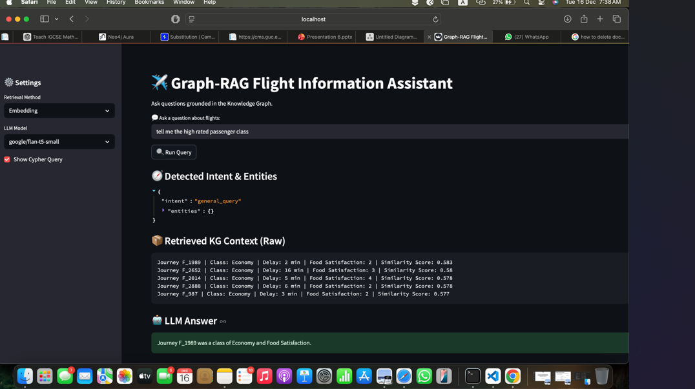
3-Graph retrieval
Embedding-Based Retrieval

Slide 18
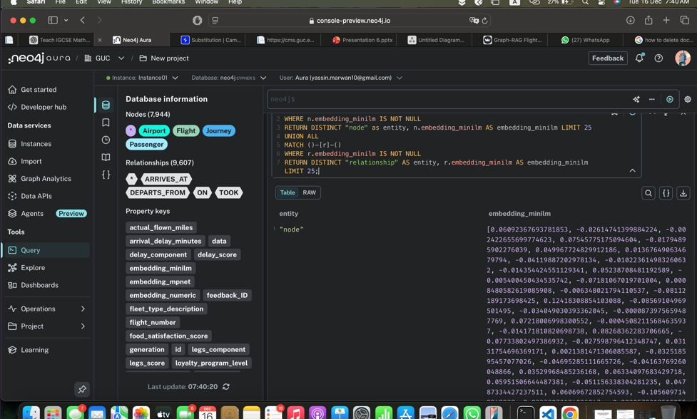
3-Graph retrieval
Embedding-Based Retrieval (Node with embedding minilm)

Slide 19
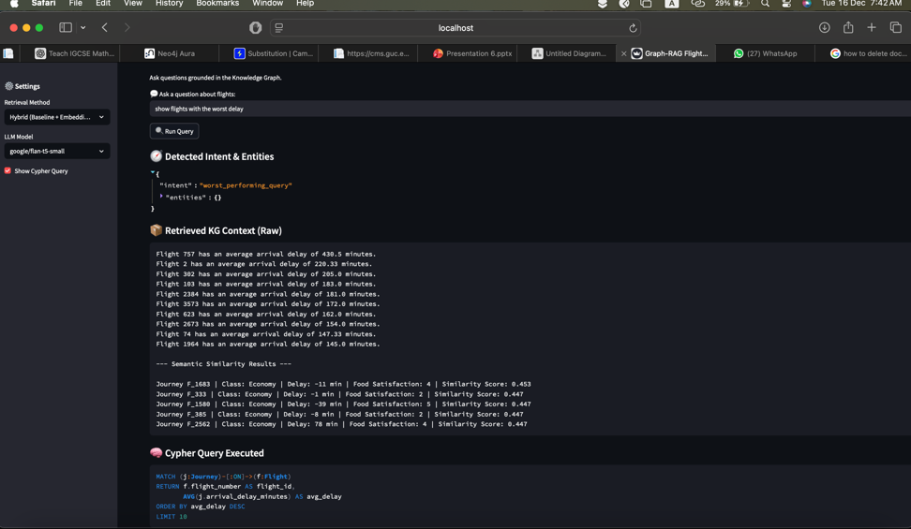
3-Graph retrieval
Hybrid system

Slide 20
4-LLM Layer – Graph-RAG Answer Generation
Input:
User query
Baseline Cypher results
Embedding-based retrieval results
Output:
Grounded natural-language answer (A conversational answer that sticks strictly to the facts found in the Knowledge Graph.)
Visual:
KG Results → Context Builder → Prompt → LLM → Answer

Slide 21
Context Construction
We merge baseline Cypher output and embedding-based retrieval results
We converts structured KG data into a compact, readable text format
Limits context size to reduce noise
The LLM receives only this context as factual input
Example Context :
Flight: MS123 | Origin: CAI | Destination: DXB | Avg Delay: 18 mins
Flight: EK202 | Avg Food Rating: 4.2 | Reviews: 120

Slide 22
Prompt Structure
Prompt is divided into three clearly separated sections:
Context: Knowledge Graph facts
Persona: Assistant role definition
Task: Explicit grounding instructions
Same prompt structure used for all LLMs
Prompt Layout:
Context: <KG-derived facts> Persona: Helpful flight information assistant Task: Answer using only the provided context

Slide 23
LLM Models & Evaluation
Model | Speed | Answer Quality | Hallucination
flan-t5-small | Fast | Acceptable | Low
flan-t5-base | Slower | Better | Very Low
Both models evaluated using identical context and prompt structure​
flan-t5-base generated more complete answers from KG context​
flan-t5-small selected when lower latency is required

Slide 24

5-Error Analysis & Improvements Embedded did not go as planned

Slide 25
6- Live demo application

